Slide 1

Executive Briefing Agent
Copilot Scenario Overview
© 2026 Microsoft Corporation All rights reserved.
Notes:
CELA disclaimer
Terms displayed or discussed are for explanation/education only. Such terms may differ from your agreement.

Slide 2
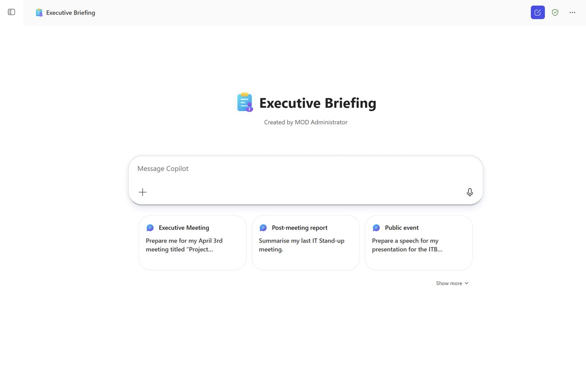
Executive Briefing Agent Summary
Key Challenges
Agent Overview
Executive preparation is manual, fragmented, and time‑consuming
Insights from meetings are not systematically captured
Alignment across media communications and interviews supports clarity and consistency in executive messaging
Provide executives with automated, consistent briefing documents before, during, and after leadership meetings, public events, and media interactions.
Business Outcomes
⏱️ Reduced prep and follow‑up time
🎯 Higher consistency and quality of executive messaging
🔄 Better continuity across communications
💼 Improved executive confidence and readiness
Technical Features
📄 Pre‑meeting talking points
📄 Executive briefing document generation
✍️ Post‑meeting executive summaries
🎤 Interview preparation with interviewer profile
📢 Public & media prep support
Notes:
CELA disclaimer
Terms displayed or discussed are for explanation/education only. Such terms may differ from your agreement.

Slide 3
Table of Contents
Overview
Persona Example
User Journey Scenario Example
Solution Screenshots
Demo Prompts, Evals Sets
Notes:
CELA disclaimer
Terms displayed or discussed are for explanation/education only. Such terms may differ from your agreement.

Slide 4
The Executive Briefing Agent supports executives across the full briefing lifecycle. Instead of manually assembling talking points from emails, documents, and meeting notes, executives simply ask Copilot to generate a briefing. The agent synthesizes Microsoft 365 content into structured briefings, ensuring executives are always prepared and aligned.
Overview
© 2026 Microsoft Corporation All rights reserved.

Slide 5


Persona Example
Whether it is a Chief of Staff assembling talking points or an executive preparing for media, the Executive Briefing Agent replaces hours of manual work with a structured document in minutes.
Executive Assistant / Chief of Staff
Executive
Preparer
Consumer
Spends hours assembling talking points before every engagement
Pulls from emails, decks, notes, and past briefings
Prepares for back-to-back meetings, events, and interviews
Needs consistent, up-to-date messaging
💬 Typical Ask
💬 Typical Ask
Always has an up-to-date briefing reflecting the latest context
Asks Copilot to generate the executive briefing and receives a structured, ready-to-share document in minutes
Key Challenges Addressed
Executive preparation is manual, fragmented, and time-consuming; insights from meetings are not systematically captured; talking points are recreated instead of evolving

Slide 6
Executive Briefing Example
The agent synthesizes Microsoft 365 content into structured briefings across the full lifecycle -- pre-meeting, post-meeting, and media preparation.
1
Trigger
2
Evaluation
3
Output
The Executive or EA asks Copilot for a briefing, e.g., "Generate talking points for tomorrow's leadership meeting" or "Prepare me for a media interview on sustainability"
Agent evaluates what is relevant, determines whether new information changes the briefing, pulls from Outlook Calendar, Email, SharePoint, OneDrive, Teams, and Word via MCP Servers
Structured executive briefing document or post-meeting summary; includes pre-meeting talking points, briefing generation, post-meeting summaries, and interview preparation
Reduced prep and follow-up time
Higher consistency and quality of executive messaging
Backbone
Better continuity across communications

Slide 7






High Level Agent Architecture
Executive Briefing Agent
Declarative agent
Email
Calendars
Attachments
Executive Briefing
Agent
Instructions
Messages
User
User asks “Prepare for my interview”
Files

Slide 8
Agent Solution Screenshots
© 2026 Microsoft Corporation All rights reserved.
Notes:
CELA disclaimer
Terms displayed or discussed are for explanation/education only. Such terms may differ from your agreement.

Slide 9
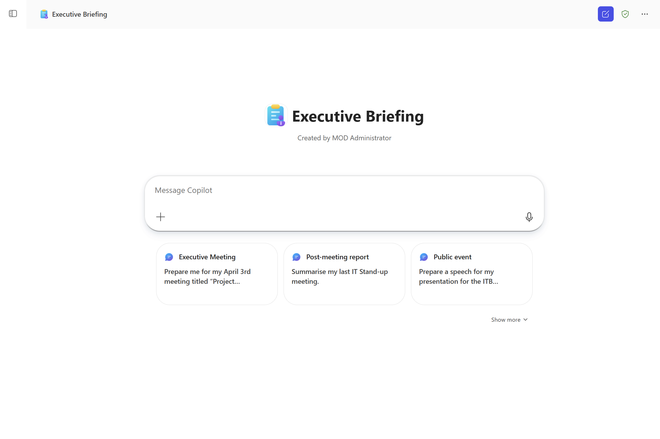
Trigger

Slide 10
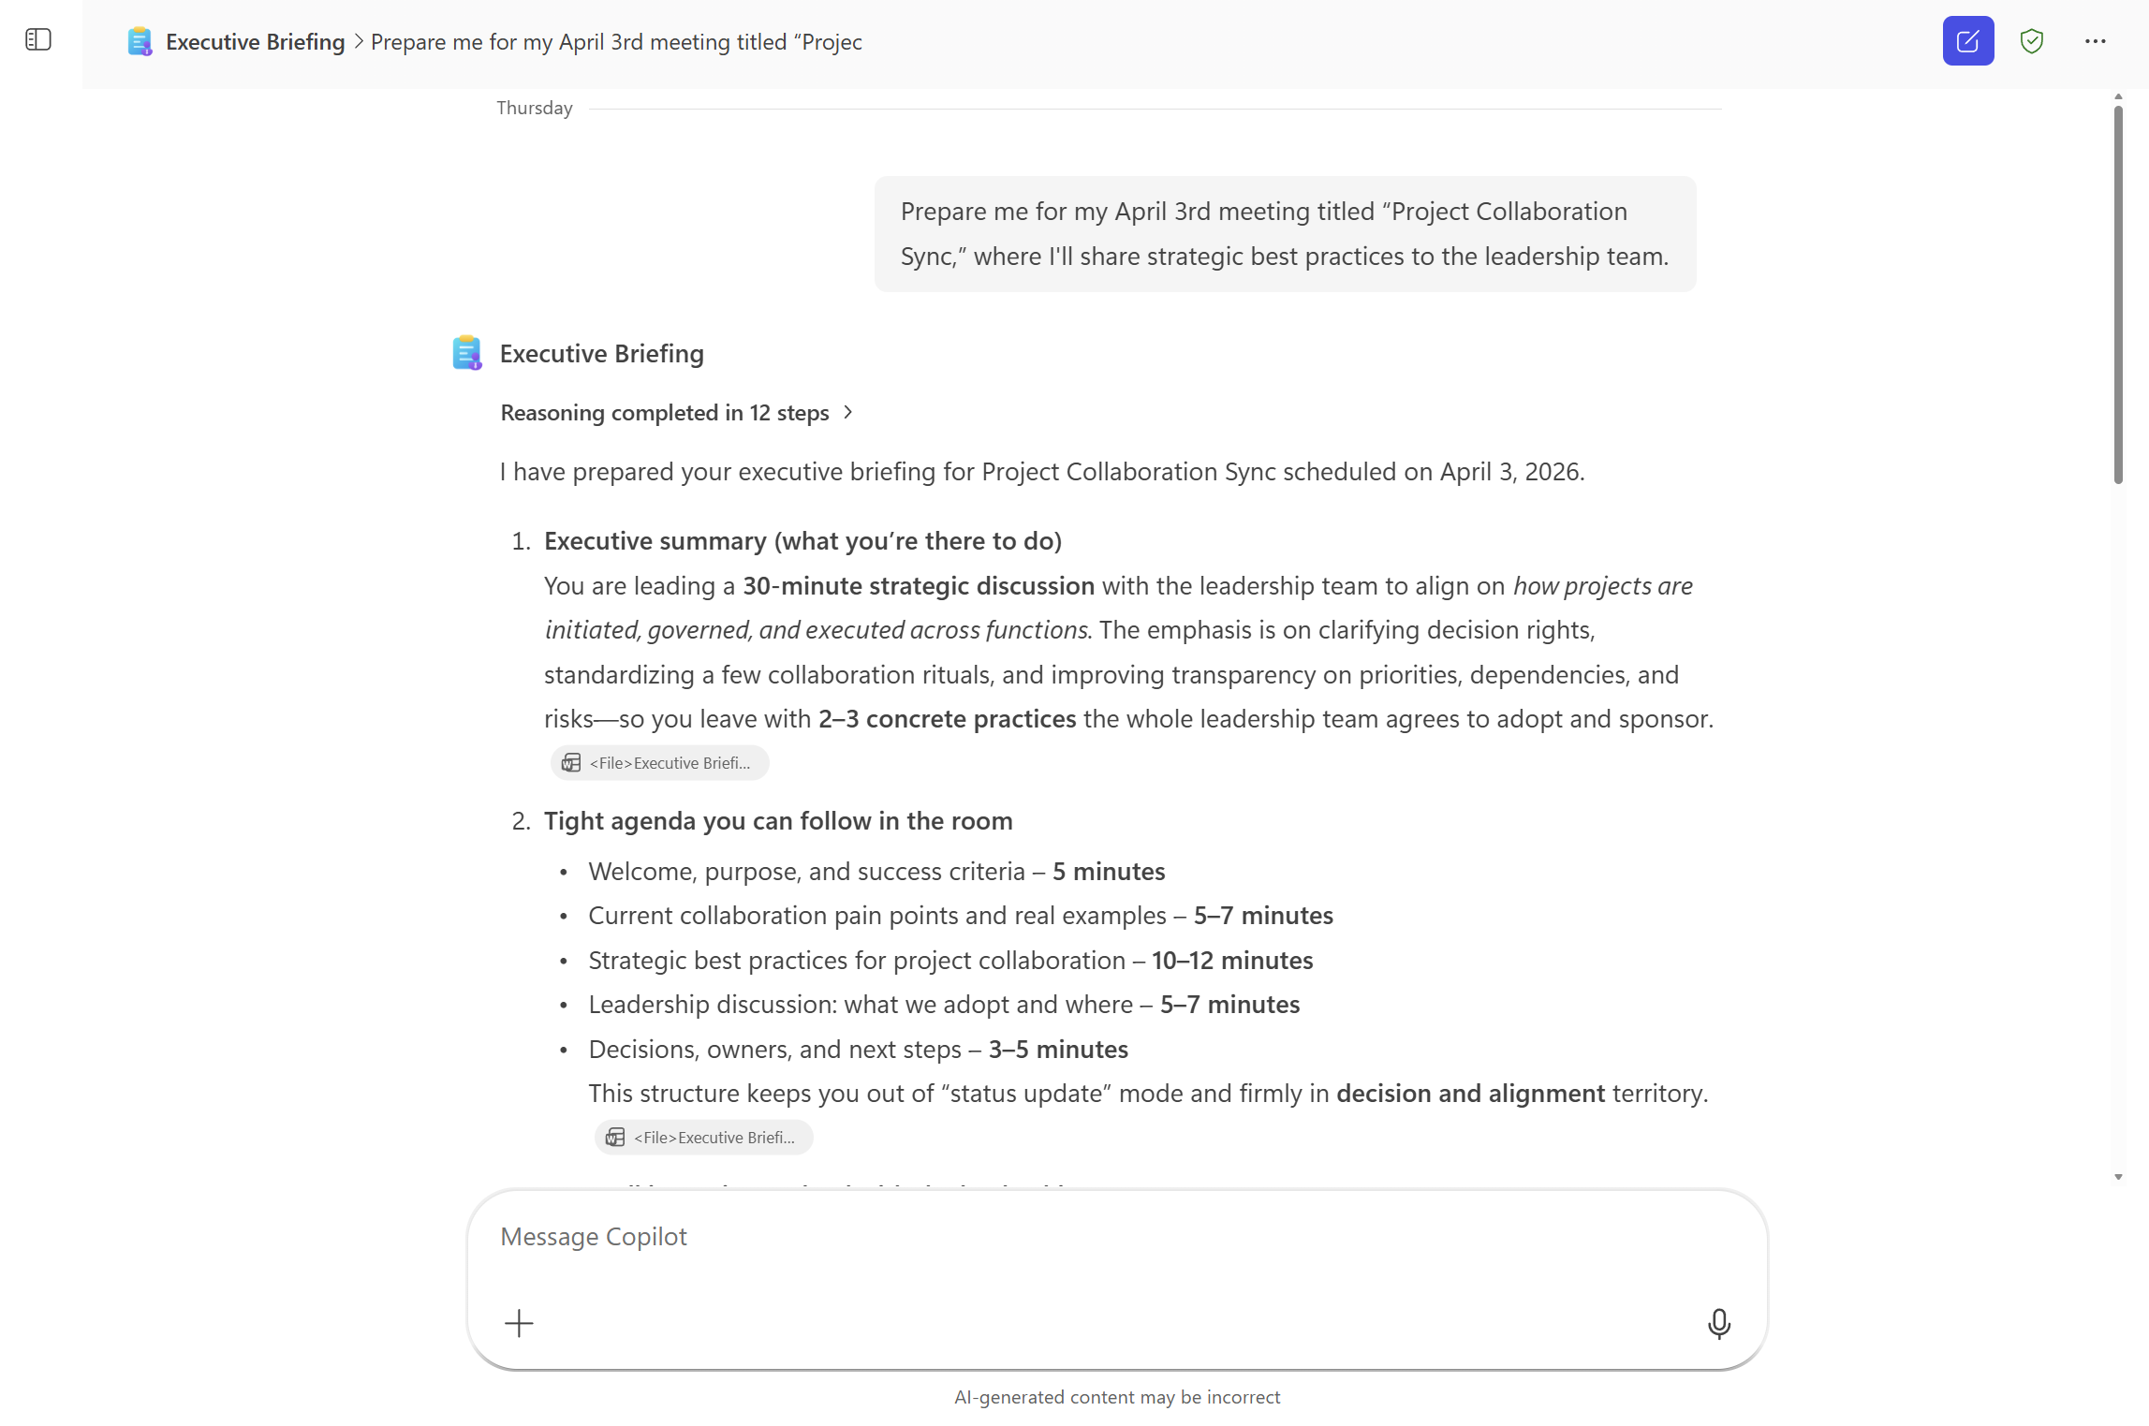
Output Example

Slide 11
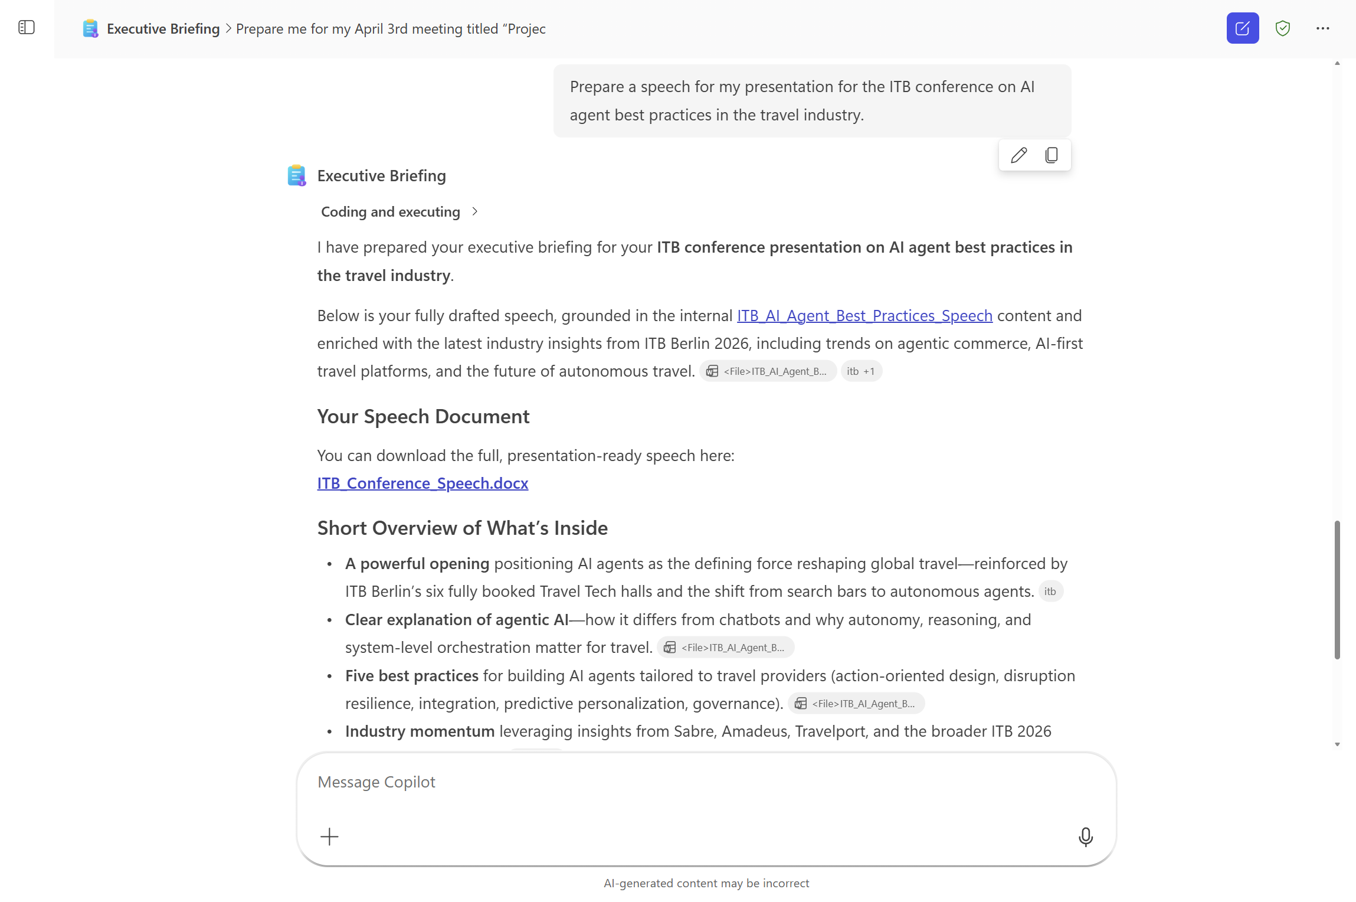
Output Example

Slide 12
Demo Prompts & Eval Sets
© 2026 Microsoft Corporation All rights reserved.
Notes:
CELA disclaimer
Terms displayed or discussed are for explanation/education only. Such terms may differ from your agreement.

Slide 13
Demo Prompts & Eval Set
Id | Test Scenario | Prompt | Expected Result
1 | Meeting Prep – Talking Points | "Generate talking points for tomorrow's leadership meeting" | Agent retrieves tomorrow's calendar event via Outlook Calendar MCP, pulls relevant emails and Teams messages, and returns a structured list of talking points aligned to the meeting agenda.
2 | Board Meeting Prep | "What should I be ready to speak about at the board meeting next week?" | Agent retrieves board meeting details from calendar, searches SharePoint for prior board materials and approved talking points, reviews recent executive communications, and returns a comprehensive topic list with background context for each.
3 | Exec Brief – Document Generation | "Create a 1 page exec brief summarizing the current state of [project name]" | Agent searches SharePoint and email for digital transformation-related content, synthesizes findings into a concise one-page Word document with status overview, key milestones, and next steps.
4 | Post-Meeting Summary – Decisions | "Summarize today's leadership meeting and highlight the key decisions made." | Agent retrieves today's leadership meeting from calendar, accesses the meeting transcript, and produces a concise executive summary listing key decisions, owners, and follow-up actions.
5 | Post-Meeting Summary – Strategy | "Create an executive summary from this morning's strategy review meeting." | Agent locates the morning meeting via Outlook Calendar MCP, extracts content from the transcript, and generates a structured summary with strategic themes discussed, conclusions reached, and next steps.
6 | Action Item Extraction | "What were the main action items from my last meeting with [Name]?" | Agent finds the most recent calendar event with the [Name of Person or Role], reviews the meeting transcript and any follow-up emails, and returns a clear list of action items with owners and deadlines where available.
7 | Briefing Document Drafting | "Draft a briefing document I can share with my team ahead of our next meeting." | Agent retrieves relevant SharePoint documents and email context for the upcoming meeting, generates a Word briefing document with sections for overview, key discussion points, and recommended actions, formatted per an approved template.
8 | Meeting Summary | "Summarize my last meeting and create a talking points document." | Agent retrieves the last meeting transcript, generates an outcomes summary, then creates talking points document in SharePoint with new insights via the Word and SharePoint MCPs.
9 | Media Interview Prep | "Prepare me for an upcoming media interview." | Agent searches SharePoint for related documents, approved messaging, and prior interview materials, then generates a prep package containing key messages, supporting points, and anticipated questions with suggested responses.
10 | Media Interview – Q&A Anticipation | "What questions might I be asked in an upcoming media interview?" | Agent reviews recent related communications from email and SharePoint, identifies key topics, and generates a list of anticipated questions with recommended response guidance for each.

Slide 14
Demo Prompts & Eval Set (continued)
Id | Test Scenario | Prompt | Expected Result
11 | Speaking Engagement – Key Messages | "Create key messages and talking points for an upcoming speaking engagement." | Agent retrieves event details from calendar, searches SharePoint for relevant content and approved messaging, and produces a structured set of key messages, supporting talking points, and narrative recommendations.
12 | Panel Discussion Prep | "Help me prepare for an upcoming panel discussion." | Agent gathers relevant content from SharePoint, recent internal communications, and approved positions, then generates a prep document with key narratives, anticipated questions, and recommended talking points.
13 | Public Appearance – Q&A Generation | "Generate anticipated Q&As for an upcoming public appearance." | Agent identifies the event from calendar, reviews related internal communications and SharePoint materials, and produces a Q&A document with categorized questions (friendly, challenging, follow-up) and response guidance.
14 | Interview Follow-Up | "What topics came up in my previous interview, and how should I follow up?" | Agent locates prior interview records and transcripts in SharePoint, extracts key topics and commitments made, and generates a follow-up prep document with continuity points and updated messaging.

Slide 15
Thank You
Notes:
CELA disclaimer
Terms displayed or discussed are for explanation/education only. Such terms may differ from your agreement.

